Slide 1
Flipkart Products analysis
Submitted by
SWATHI VANDANA

Slide 2
Problem Statement:
To analyze variation of different dimensions of Flipkart E-Commerce site data.

Slide 3




Tools used:
Talend
Cloudera
Hive
Data bricks

Slide 4
Dataset Description:
There are 14 Columns in Dataset.
uniq_id, crawl_timestamp, product_url, product_name, product_category_tree, pid, retail_price, discounted_price, image, is_FK_Advantage_product, description, product_rating, brand and number_of_reviews.
Dataset contains 20,000 rows.
This is a pre-crawled dataset, taken as subset of a bigger dataset (more than 5.8 million products) that was created by extracting data from Flipkart.com.

Slide 5
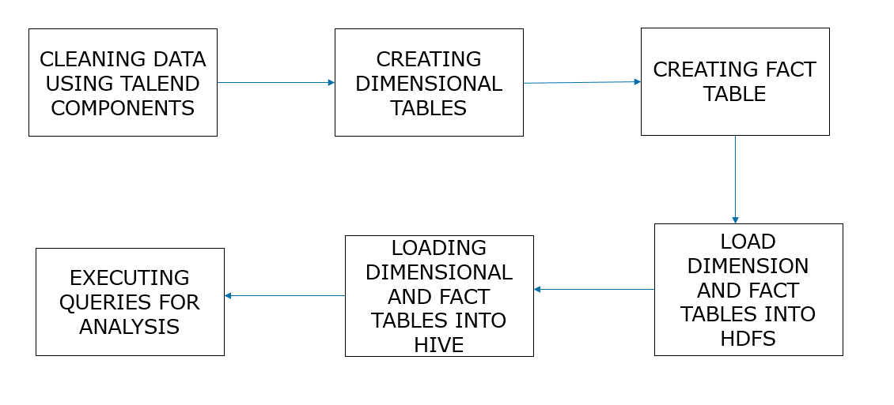
Work Flow:

Slide 6
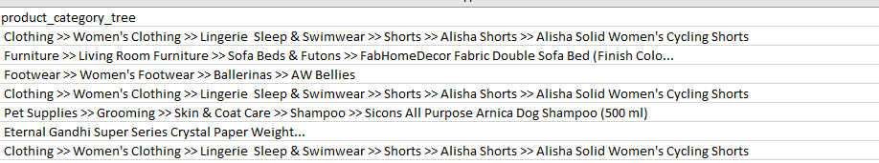
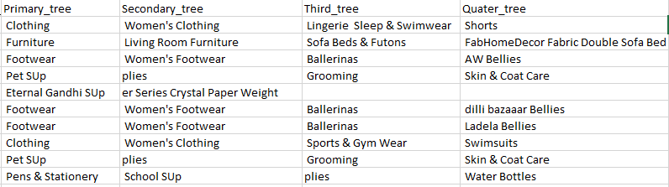
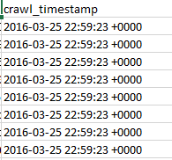
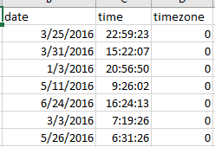
Data cleaning:

Slide 7
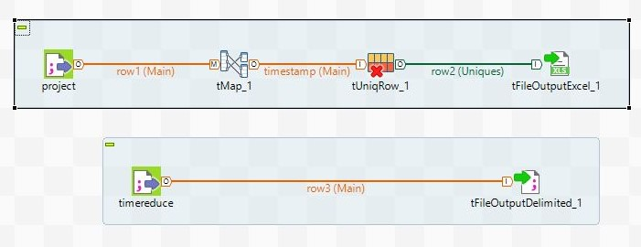
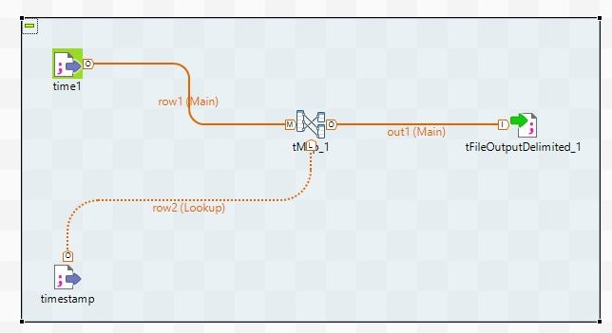
Data cleaning and creating dimensions and fact tables using Talend:

Slide 8
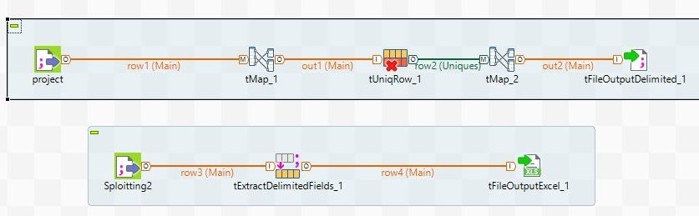
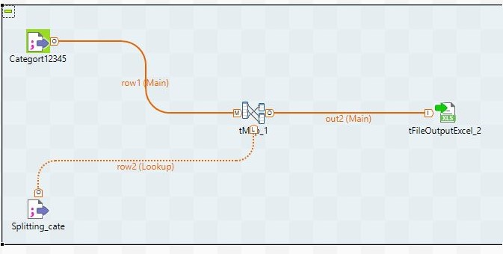
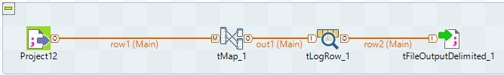

Slide 9
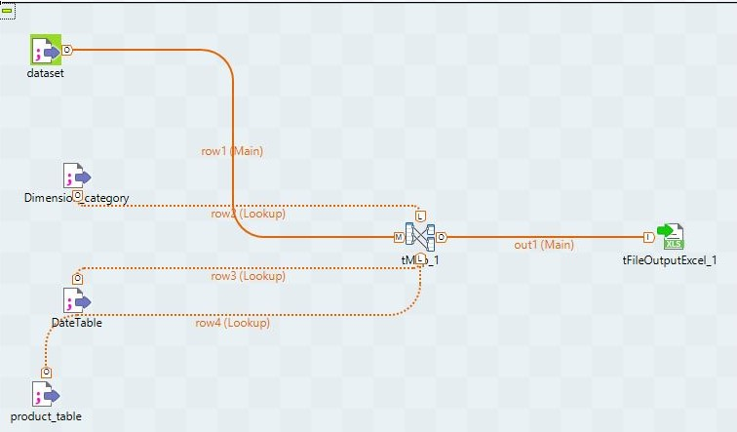
Fact table created in talend:

Slide 10
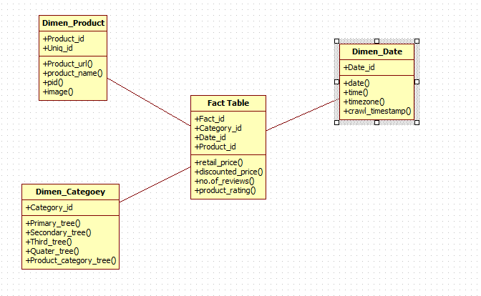
Data model:

Slide 11

Loading data into hdfs:

Slide 12
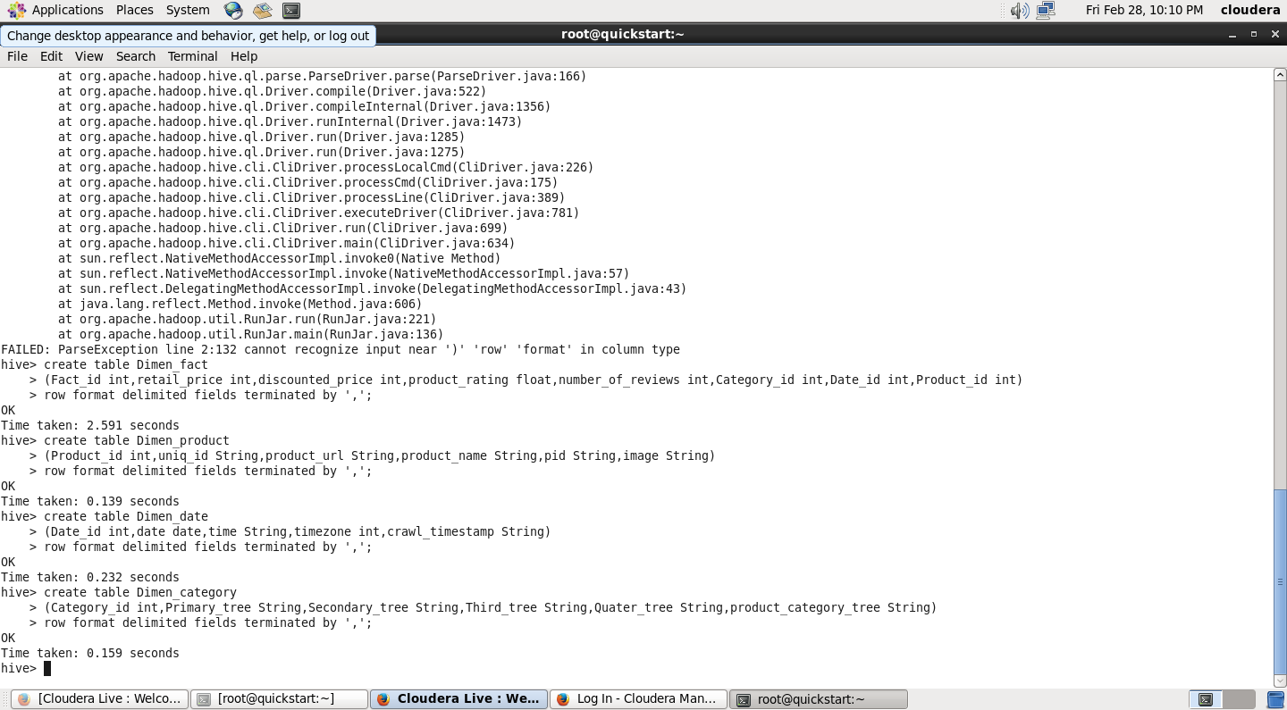
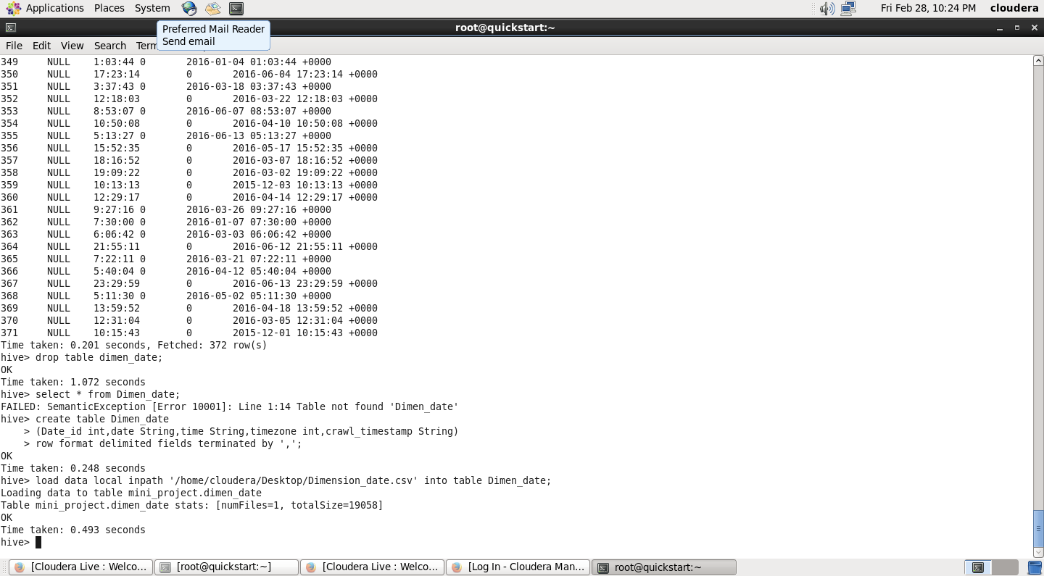
Creating tables in hive:

Slide 13
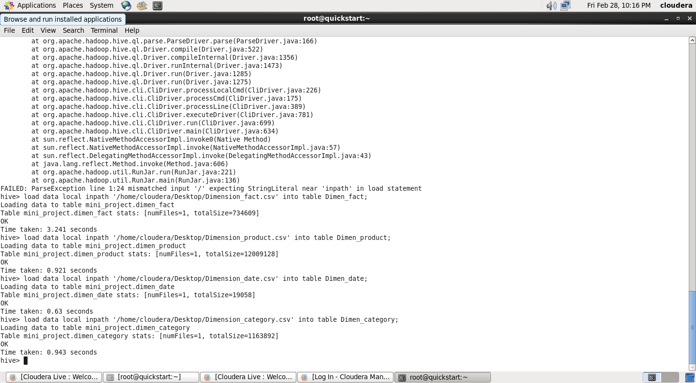
Loading data into hive tables:

Slide 14
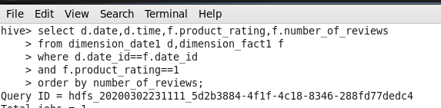
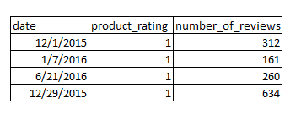
Analysis of data:
Product analysis based on rating and number of reviews:
Query 1:
Output:

Slide 15
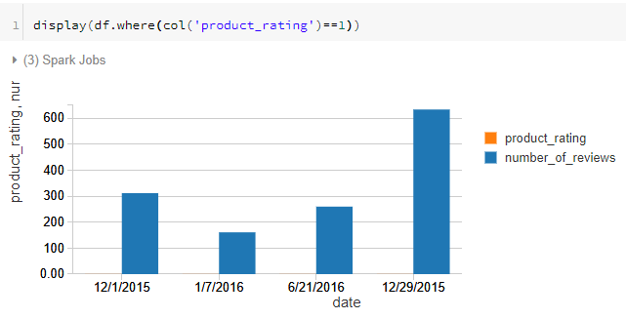
Graphical representation:

Slide 16

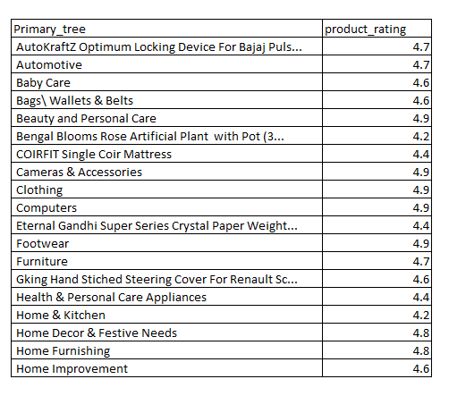
Product analysis based on product rating and primary tree
Query 2:
Output:

Slide 17
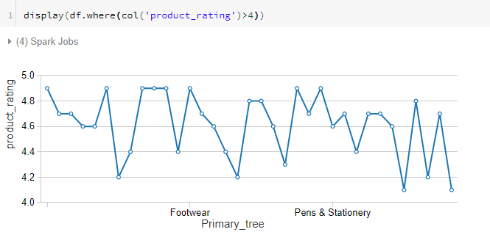
Graphical representation:

Slide 18

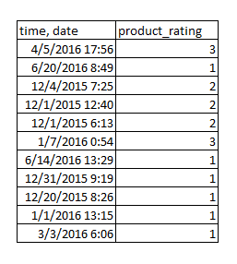
Product analysis based on product rating and date:
Query 3:
Output:

Slide 19
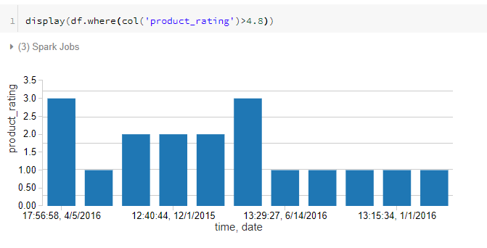
Graphical representation:

Slide 20

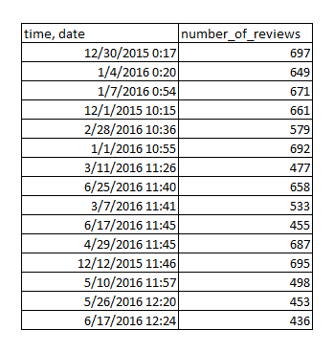
Product analysis based on number of reviews
Query 4:
Output:

Slide 21
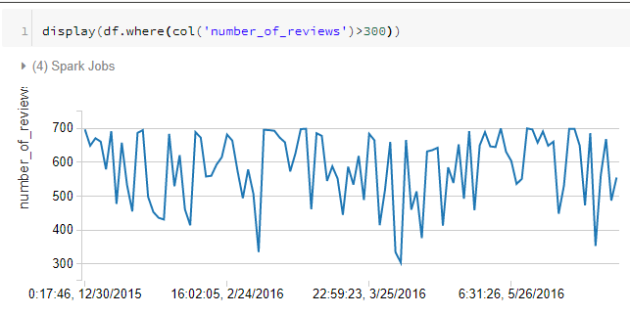
Graphical representation:

Slide 22
Conclusion:
The Data modelling used is efficient enough to get a clear instance of data in all three perspective which are user, Flipkart and different products perspective. This dataset is a pre-crawled dataset, therefore lesser variation is found. Still a great vision of insights of Flipkart data can be analysed.

Slide 23
Thank you

